Slide 1
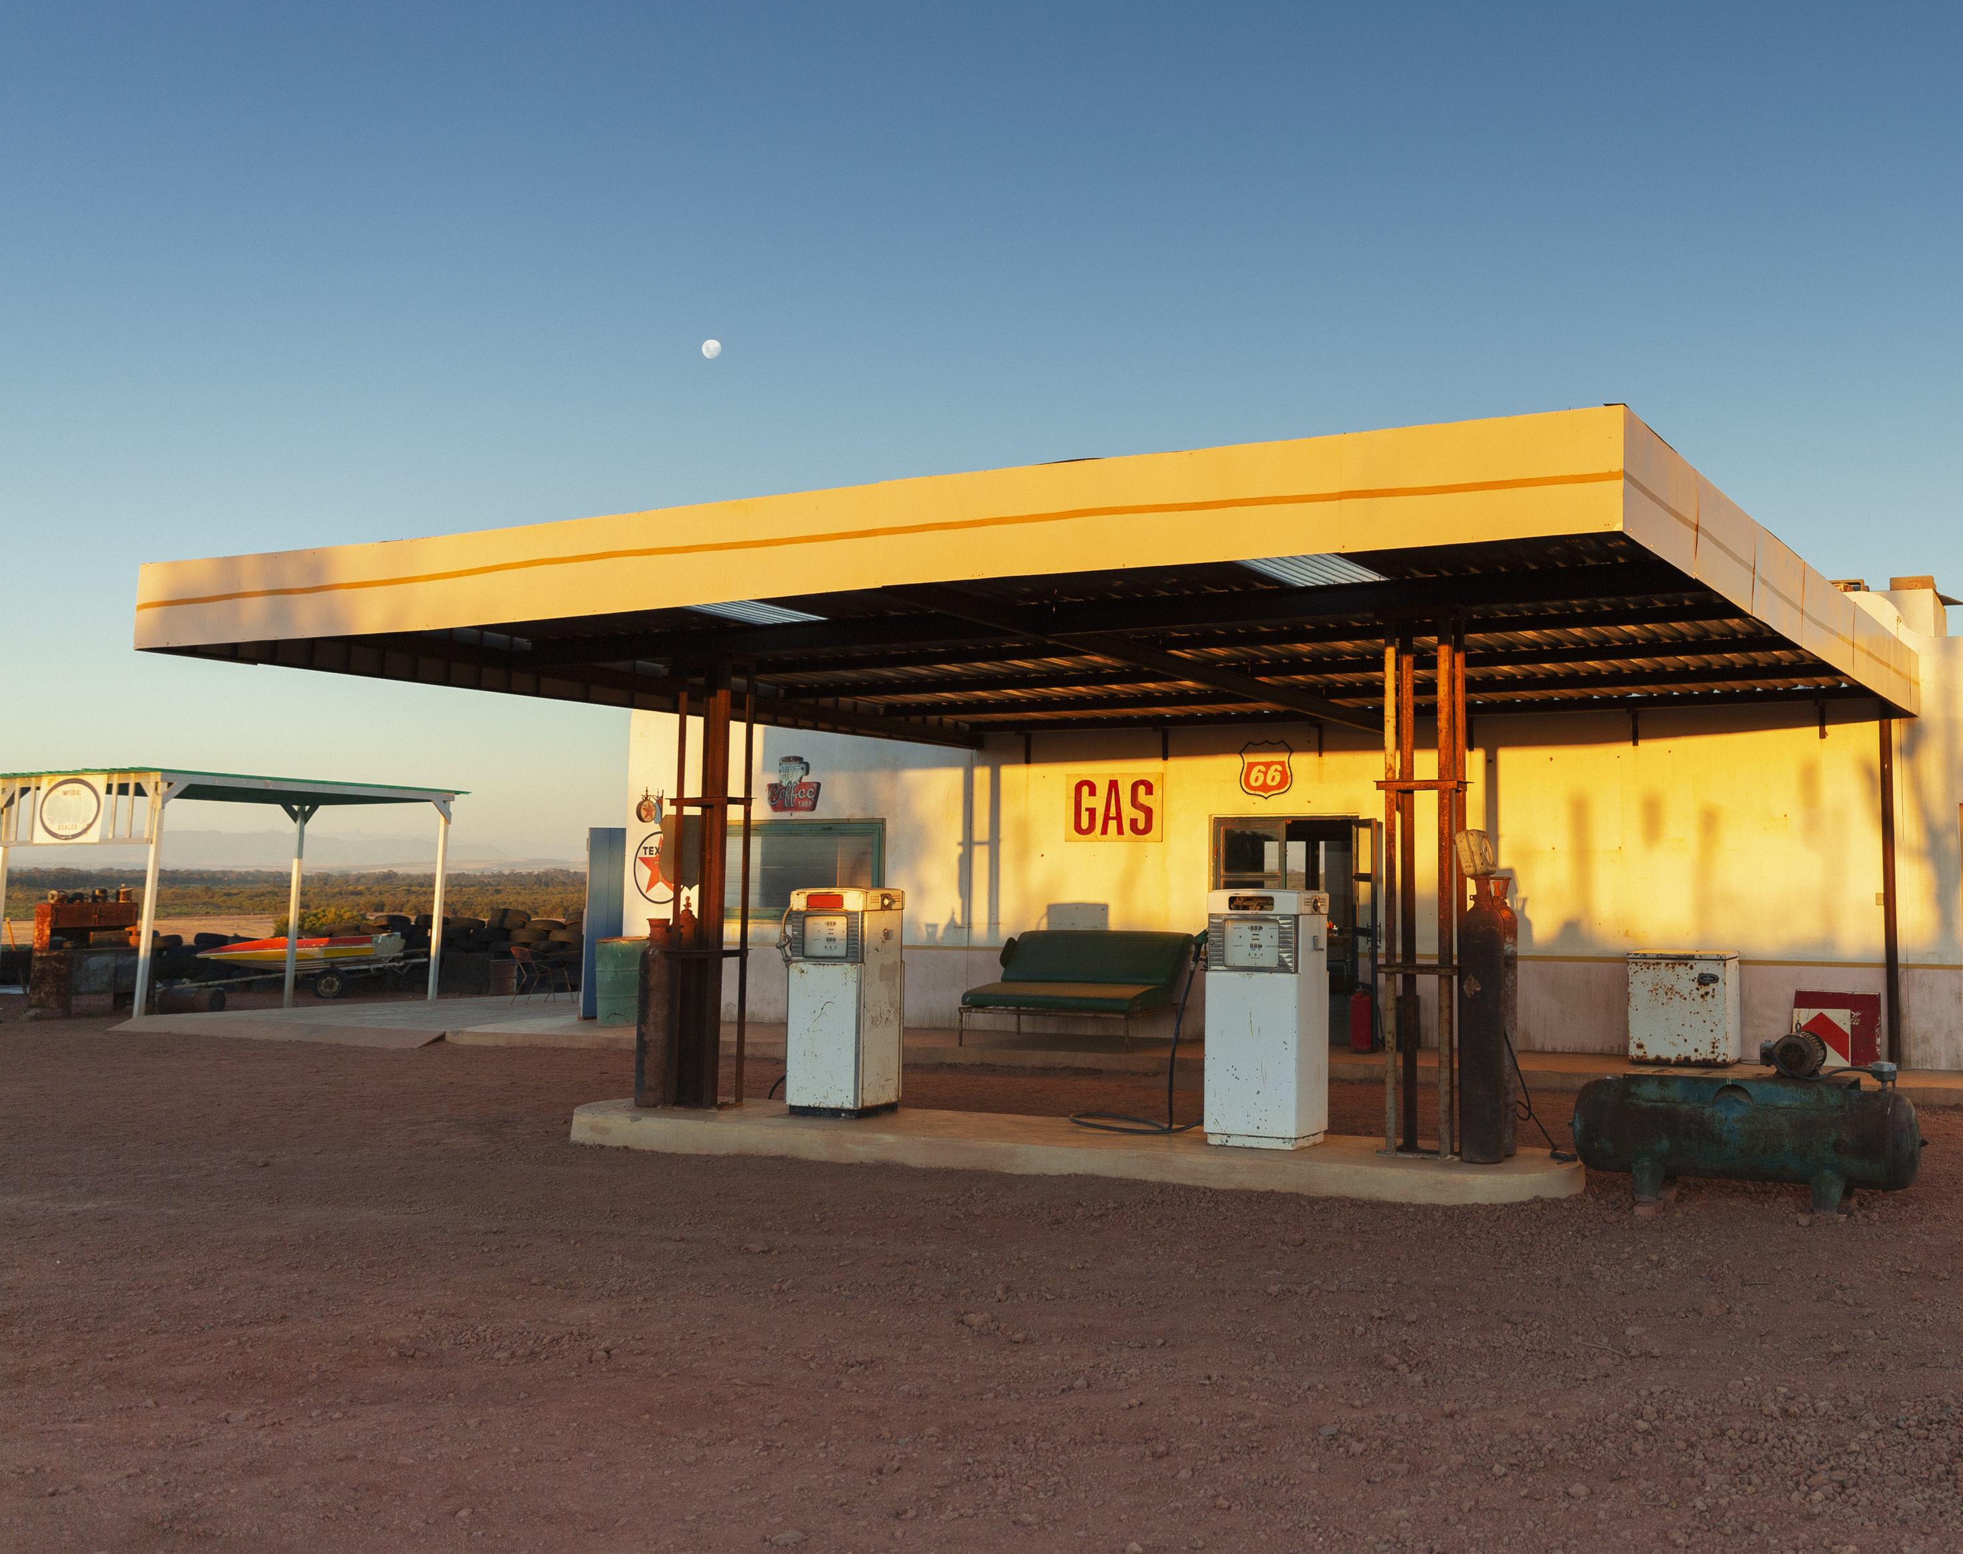
Discussion of Prohibition of New & Expanded or Reconstructed Service Stations in Pinole
Tuesday, February 6, 2024
City Council

Slide 2
Background & Tonight’s Agenda
July 18, 2023: Future agenda item request (Councilmember Sasai)
Tonight’s Agenda:
The current landscape of state and local legislation related to carbon neutrality
Gas station regulation in other communities
Climate Emergency Policies in Pinole
Pinole's existing service station inventory
Pinole's existing service station regulations
Pinole's fuel sales tax information
What it means to become a nonconforming use
Options for establishing regulations prohibiting creation of new gas stations, and the expansion, reconstruction and relocation of existing gas stations, in Pinole

Slide 3
State Legislation Related to Gas Vehicles
Carbon neutrality is the point at which the removal of carbon pollution from the atmosphere meets or exceeds emissions.
In 2018 Governor Brown enacted Executive Order B-55-18, calling for carbon neutrality in California by 2045.
In 2020, Governor Newsom issued Executive Order N-79-20, no sales of new gas-powered passenger vehicles and certain freight trucks by 2035 and medium and heavy-duty trucks by 2045.
In 2022, the California Air Resources Board approved the Advanced Clean Cars II rule. By 2035, 100% of new cars and light trucks sold in California must be zero-emission vehicles, which also includes plug-in hybrid electric vehicles.

Slide 4
Gas/Service Station Regulation in Other Communities
City | County | Date of Ban | # Existing and Proposed Gas Stations Regulated by Ordinance | Population
Petaluma | Sonoma | Mar 2021 | 17 | 59,403
Rohnert Park | Sonoma | Mar2022 | 13 | 44,411
Sebastopol | Sonoma | Apr 2022 | 3 | 7,448
Cotati | Sonoma | Jun 2022 | 5 | 7,498
Windsor | Sonoma | Oct 2022 | 4 | 26,039
Santa Rosa | Sonoma | Aug 2022 | 44 | 176,938
Sonoma County | Sonoma | Mar 2023 | 46 | 485,887
Yountville | Napa | Sept 2023 | 1 | 3,360
American Canyon | Napa | Feb 2022 | 3 | 21,605
Calistoga | Napa | Dec 2021 | 3 | 5,187
Napa | Napa | Apr 2023 | 20 | 78,818
St. Helena | Napa | Ban is pending | 3 | 5,386
Novato | Marin | October 2022 | 14 | 52,708
San Anselmo | Marin | November 2023 | 3 | 12,693
Fairfax | Marin | November 2023 | 2 | 7,521

Slide 5
General Approach to Enacting Regulations
Adopting an Emergency Ordinance declaring a Climate Action Emergency
Considering a moratorium or other temporary regulations prohibiting gas stations while permanent regulations are drafted
Conducting public outreach to determine public support for a permanent ban on service and fueling stations that use fossil fuels.
Addressing issues such as creating legal non-conforming land uses, determining the extent of improvements existing fueling stations may undergo, and incentivizing the transition to alternative fuels
Initiating a Zoning Ordinance Text Amendment to ban new, expanded, reconstructed, or relocated gas stations, updating fueling station definitions, addressing legal non-conforming uses, and promoting alternative fuels.
Initiating a General Plan/Specific Plan Amendment to provide internal consistency in addressing the Climate Action Emergency and complement the Zoning Ordinance Text Amendment.
Completing the public review process, including workshops, PC recommendation, and City Council adoption.

Slide 6
Climate Emergency Policies in Pinole
Prior to 2021:
Adopting and implementing the General Plan Sustainability Element,
Selecting MCE as the default electricity provider for residents and businesses,
Investing in energy conservation for some City operations.
2021: Resolution 2021-93 declaring a climate emergency and directing Staff to take certain actions.
2022: Greenhouse Gas (GHG) inventory to establish a baseline of GHG emissions.
The inventory showed that the highest sector of GHG emissions is from on-road transportation in Pinole, at over 30,000 MT CO2e (metric tons carbon dioxide equivalent).
Climate Action and Adaptation Plan (CAAP) - public review in March 2024.
The CAAP will target reducing emissions in Pinole from 2017 levels of 72,196 MT CO2e to 58,004 MT CO2e by 2030 and 0 MT CO2e by 2045.

Slide 7
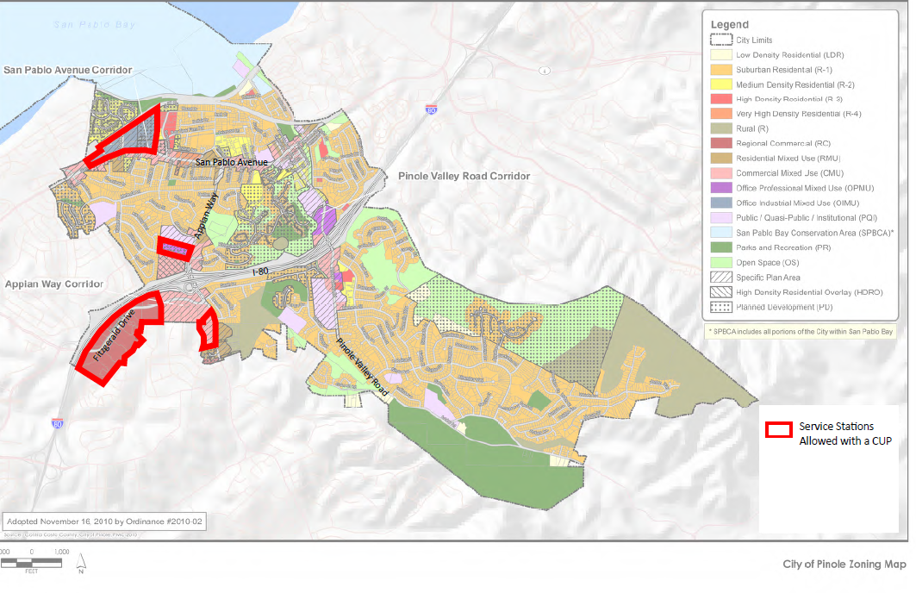
Where are Service Stations in Pinole Allowed?
Service Stations: retail businesses selling gasoline or other motor vehicle fuels.
Allowed with a CUP only:
OIMU in the Service Sub-Area in the San Pablo Avenue Corridor.
OPMU in the Service Sub-Area in the Appian Way Corridor.
CMU in the Mixed Use Sub-Area in the Appian Way Corridor.
RC Zoning District.

Slide 8
Existing Regulations: Service Stations
Chapter 17.44 incentivizes the expansion, modification, or retrofit of an existing service station to incorporate biodiesel or other alternative fuels or charging stations for electric vehicles via simple administrative plan check procedures.
New Stations: Comprehensive Design Review and Conditional Use Permit.
Location requirements
Development and design standards
Existing service stations and modifications to existing service stations are generally exempt from the regulations in Chapter 17.34.
Chapter 17.34 also specifies that grounds for revocation of the CUP for a service station include discontinuation of the station for any reason for a continuous period in excess of 180 days.

Slide 9
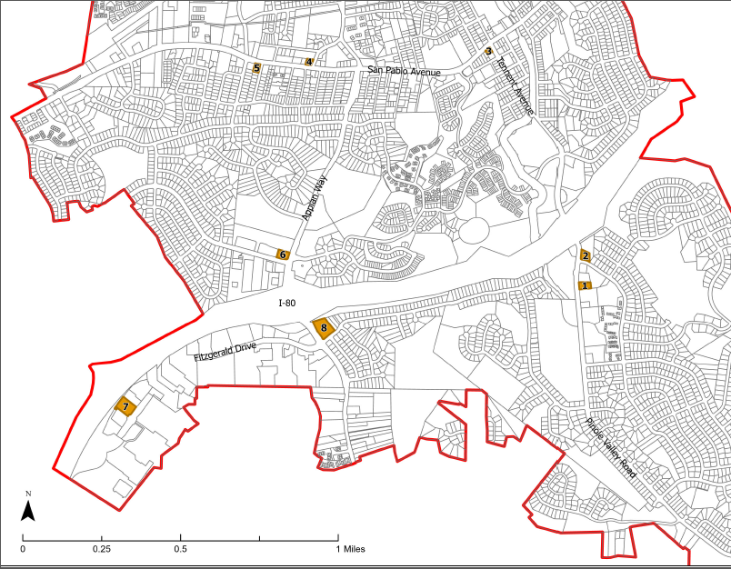
Existing Service Stations in Pinole
ID | Station | Address | Zoning District | Built (effective year)
1 | ARCO | 2737 & 2747 Pinole Valley Rd | CMU (Commercial Mixed Use) | 1976
2 | Chevron - Pinole Valley | 2695 Pinole Valley Rd | CMU | 1959 (1970)
3 | Pump House | 700 Tennent Ave | CMU | 1961 (1965)
4 | Grand | 1390 San Pablo Ave | CMU | 1984
5 | Smart Stop | 1007 San Pablo Ave | CMU | 1984
6 | Chevron - Appian Way | 2298 Appian Way | CMU | 1967 (1980)
7 | Shell | 1401 Fitzgerald Dr | RC (Regional Commercial) | 1999 (2000)
8 | 1401 Fitzgerald | 2401 Appian Way | CMU | 1999 (2000)

Slide 10
Gas Sales Tax Information
Taxable sales in the Fuel and Service Station Business Group
FY 12/13 | FY 13/14 | FY 14/15 | FY 15/16 | FY 16/17
$ 428,169 | $ 426,327 | $ 431,453 | $ 393,583 | $ 355,390
FY 17/18 | FY 18/19 | FY 19/20 | FY 20/21 | FY 21/22
$ 362,450 | $ 482,117 | $ 370,686 | $ 412,186 | $ 596,460
10-year Average
$ 425,882

Slide 11
Non-Conforming Use Regulations in Pinole
Continuation- Nonconforming uses can continue to operate, be transferred, or sold without enlargements or intensifications. Evidence must show it existed before the Zoning Code provision prohibiting the use. The Community Development Director has the authority to make such determinations.
Maintenance - Maintenance of a nonconforming structure is allowed if it follows the building code requirements at the time. Repair work for safety or fire hazard can include structural alterations. Expanding or replacing non-conforming structures is not allowed. Repairs or alterations to comply with safety standards are allowed.
Modification, Expansion and Reconstruction - Changes to a structure must comply with the Zoning Code, and cannot create new nonconforming conditions. The approving authority may consider expanding a nonconforming use up to 10% of the structure. Exterior improvements require design review approval.
Structural Alterations - Nonconforming use of a building can be changed to another nonconforming use of the same or more restricted classification without structural alterations.
Repair/Replacement of Destroyed Buildings - Damaged structures can be rebuilt without City Council approval if the cost of reconstruction is less than 50% of the original value. A building permit is required, and a CUP is needed to increase the original footprint up to 10%.
Loss of Nonconforming Status - Nonconforming use of a property ends if it's discontinued or abandoned for 6+ months. Any future use of the property must comply with all zoning regulations. Evidence of an intention to abandon and an act or failure to act which shows that the owner no longer claims or retains an interest in the nonconforming use is required to determine whether a use has been abandoned.

Slide 12
Options for Next Steps
1. Short Term
Direct start to return with an Interim Urgency Ordinance, which would temporarily halt approval of building permits or other entitlements for new service station uses or the expansion of existing service station uses; and
Direct the CAAP include an action to go through a public process to adopt permanent regulations prohibiting the expansion, reconstruction, and relocation of existing service stations prior to the end of the Interim Urgency Ordinance.
2. Permanent Regulation Process
1. Determine and define an outreach process to gauge level of support
2. Prepare a General Plan, Specific Plan, and Zoning Ordinance text amendment, which would establish Service Station land use as Not Permitted
5. Continue to direct staff to explore options for additional charging at City-owned/maintained properties and private facilities for public benefit.
4. Take the Amendments through the required public review process, including Planning Commission recommendation and City Council adoption.
3. Evaluate streamlining and incentivizing enhancements

Slide 13
Fiscal Impact
The cost of preparing amendments to the General Plan, Specific Plan and Zoning Ordinance is associated with the time spent by the staff to make such amendments.
It is uncertain how much revenue the City will lose in sales tax by prohibiting future gas stations. A shift to taxation of EV charging (which is still unknown) may end up filling the gap to some extent, especially paired with a strong push by the City to encourage ample EV charging facilities in Pinole.

Slide 14
Options for next steps
Direct start to return with an Interim Urgency Ordinance, which would temporarily halt approval of building permits or other entitlements for new service station uses or the expansion of existing service station uses; and
Direct the CAAP include an action to go through a public process to adopt permanent regulations prohibiting the expansion, reconstruction, and relocation of existing service stations prior to the end of the Interim Urgency Ordinance.

Slide 15
Staff Recommendations
Staff recommends that the Council receive information and provide staff with appropriate direction for future actions, if any.

